Slide 1
Today’s Schedule
10:00-11:00 - How Much Money Could My District Save w/ MSFBG?
11:00-11:45 -The MSFBG Award Process From A-Z
11:45 – 12:00 General Parts “Hello”
12:00-2:00 – Tasting Event
2:01 – Happy Friday, GO HOME ☺

Slide 2
The MSFBG Award Process From A-Z
April 27, 2018 11:00-11:45

Slide 3
WELCOME
Laura Metzger, MSFBG Consultant

Slide 4
Agenda
Review of MSFBG
Current Status of MSFBG
What is the “Voting Team”
Specifications
Commitments
Bid Process
Evaluation Process
Award Process
Cost Savings

Slide 5
What is MSFBG?
What is the MSFBG?
MSFBG = Minnesota School Food Buying Group
A food/non-food buying group with joint purchasing agreement with Anoka Hennepin School District

Slide 6
What are the main goals of MSFBG?
To lower food and supply costs through volume purchasing to save time and money.
Provide current nutrition information in one place.
Bid items where 80% of school district’s food dollars are spent

Slide 7
How Did It All Get Started?
Started in the 2006-07 school year with 15 districts
Looking for savings that would be the same for all districts
1 bid process for an entire school year
Notes:
looking for ways to reduce their food costs. The group believed that they could attain savings through volume buying and worked to reach consensus to purchase one item in its category type. A bid was developed that asked for delivered price to the distributor without any bill backs or rebates that would be the same for all MSFBG districts, and that would be guaranteed for the entire school year. By the second year the districts projected close to $1,000,000 in combined savings.

Slide 8
How Did It Work Out?
By the 2nd year, the districts projected a combined savings close to
$1,000,000
Notes:
looking for ways to reduce their food costs. The group believed that they could attain savings through volume buying and worked to reach consensus to purchase one item in its category type. A bid was developed that asked for delivered price to the distributor without any bill backs or rebates that would be the same for all MSFBG districts, and that would be guaranteed for the entire school year. By the second year the districts projected close to $1,000,000 in combined savings.

Slide 9
Fast Forward 11 Years…

Slide 10
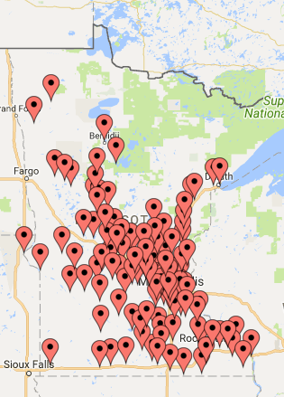
130 Participating Districts

Slide 11
Current Distributors
Food Services of America – Fargo/Moorhead
Indianhead – Eau Claire, WI
Martin Brothers – Cedar Falls, IA
Reinhart – La Crosse, WI
Reinhart - Marshall
Reinhart - Rogers
Sysco – Fargo, ND
Sysco MN
Sysco Western MN - St. Cloud
Upper Lakes Foods – Cloquet
US Foods – Grand Forks, ND
US Foods – Plymouth
US Foods - Sioux Falls, SD

Slide 12
What is Anoka Hennepin’s Role?
Each district signs a joint purchasing agreement with Anoka Hennepin Schools
Anoka Hennepin manages the bid process for the group, in compliance with MN Statute
Anoka Hennepin currently has 1 voting team member
Anoka Hennepin purchasing department handles all legal bid requirements and contracts
Anoka Hennepin hires the MSFBG consultant
Anoka Hennepin hosts the MSFBG website

Slide 13
What Is The Voting Team?
Kim Franta –Eastern Carver County
Andrea Schaak – Jordan
Stephany Stromme – Northfield
Gayle Smalley-Rader – Lakeville
Jeff Wolfer – West St. Paul, Mendota Heights, Eagan
Kim Harren – Hastings
Barb Griffiths – Eagan, Apple Valley, Rosemount
Pam Haupt – Richfield
Lesli Mueller - Hutchinson/Litchfield
Michelle Johnson – Howard Lake/Waverly/Winsted
Kris Larson – Delano
Colleen Fairbanks -Osseo
Adele Lillie – Robbinsdale
Patty Duenow – Anoka-Hennepin
Notes:
14 Districts

Slide 14
What is a specification?
A Product Specification is a document that provides critical defining information about a product and can include a list of rules, bans and standards that apply to the item.

Slide 15
Examples of Current Specifications

Slide 16
How Does The Voting Team Write A Spec?
Look for an example already created and edit to MSFBG needs
Write from scratch
Specific product makeup (chicken, beef, pasta, bread, etc)
Specific size
Meat/meat alternate or grain requirements
Nutrition requirements
Ingredients or allergens to list
Specific shape
Packaging type – IW, bowl, pouch, dispensing pouch, #10 can, 20 oz, etc
Ready to use, frozen, par baked, IQF, etc.
Multiple flavors/varieties

Slide 17
Other Factors Considered….
MSFBG doesn’t list specific brand names
The goal of MSFBG is to drive pricing down on items which is done through competitive bidding from manufacturers. Leaving off brand specific requirements creates more competition
MSFBG writes specifications that have multiple manufacturers that can bid on the specification
Product availability through distributors

Slide 18
Ideas For New Specifications?
Email:
MSFBG@ahschools.us
Watch for surveys requesting ideas

Slide 19
Specifications Timeline
Voting Team reviews in the fall during September, October, and November months
Final and official specifications need to be finished by November 1st of each calendar year
Specifications are released to school districts for the commitment process early November (2 week timeframe)

Slide 20
What’s the Commitment Process?
Participating districts estimate usage for specified items for the following school year.
The estimated number of cases is entered into an online system currently called Interflex (similar to cLiCs).
Each specified item needs a community commitment of 2000 cases in order for it to be put on a bid.
Districts are expected to purchase items they have committed to during the following school year.

Slide 21
Commitment FAQs
Do I have to enter commitments?
No, however there is a 2 part response
The greater the volume in # of cases, the lower the bid price. If every district committed to as little as 15-20 cases of a particular specification it could decrease the manufacture bid price
Also, if every district committed to as little as 15-20 cases of each specification, every specification would be sent to bid since the 2000 case threshold was met

Slide 22
Commitment FAQs
What if I enter commitments and then decide not to actually use the product once it’s awarded?
If you know you will not use an awarded product and you committed to a # of cases, please connect with your distributor to let them know of the change. Also, contact a broker or manufacturer.

Slide 23
Commitment FAQs
Can I still buy an awarded item if I didn’t commit in the previous fall?
Yes, you are able to take advantage of the awarded item’s pricing even if you didn’t commit to a certain # of cases. The problem with not committing and purchasing the awarded product is the MSFBG purchasing group as a whole could have seen a lower bid price if schools would have committed in the fall.

Slide 24
Bid Process
All specifications meeting 2000 case thresholds are put on the bid
Bid is released in late November/Early December via Interflex
Bid is closed early January

Slide 25
Bid Process
Once bid is closed, MSFBG consultant and voting team get to work
Paper evals – to ensure products bid meet paper specification
Tasting/Visual Evals – to ensure products bid meet acceptability standards

Slide 26
Evaluation Criteria
Food Items:
The two lowest cost items meeting specifications will be evaluated first.
The items will be evaluated in a blind tasting where the item will be evaluated on a 1 to 5 scale for appearance, aroma, taste, texture, and packaging.
The item will be assigned a score in each category.
The item must score a minimum of a 3 in each category to be considered acceptable.
If the lowest cost item is considered acceptable, no more items will be tested.
At no time are items considered on a side by side basis, and at no time will the testers know the price or vendor of the product they are testing.

Slide 27
Evaluation Criteria
Non-Food Items:
The two lowest cost items meeting specifications will be evaluated first.
The items will be evaluated in a blind tasting where the item will be evaluated on a 1 to 5 scale for appearance, package integrity, usability, strength, and aroma .
The item will be assigned a score in each category.
The item must score a minimum of a 3 in each category to be considered acceptable.
If the lowest cost item is considered acceptable, no more items will be tested.
At no time are items considered on a side by side basis, and at no time will the testers know the price or vendor of the product they are testing.

Slide 28
Bid Announcement and Bid #2
Awarded items are announced in early March
If issues present with a specification during Bid #1, the voting team will decide the cost/benefit analysis if a bid #2 is required

Slide 29
Bid 1 & 2
First Bid #1 was announced 2/28/18 and posted on the website
www.ahschools.us/msfbg
Second Bid #2 was approved by school board 4/23/18
Will email update to:
Participants
Manufacturers/Brokers
Distributors
The new items will be added to the website by next week

Slide 30
Awards
178 items were awarded
Items rescinded
McCain Hash Brown Patty
Nardone 4 Cheese Pizza & Pepperoni Pizza
Barrel O Fun Potato Chips
207060212
207040212

Slide 31
Participation Fees Sent in April
$450 for districts with 3,000 students or less
$800 for districts with more than 3,000 students
Annual Fee

Slide 32
So…How Much Is My District Saving?

Slide 33
MSFBG Cost Savings
District with < 2000 students saved on avg: $20,000/year on annual food purchases.
Districts with < 10,000 students saved on avg: $50,000/year on annual food purchases.
Single Line item savings:
Ketchup > $1,000 on district < 2,000 students
Orange Juice w/calcium >$2,000 on district <2,000 students
Apple Juice w/calcium > $3,000 on district <2,000 students
Garlic Cheese Bread
> $8750 on district > 30,000 students
> $1250 on district < 5,000 students
> $2100 on district < 15,000 students
Pizzas
>$500 on district < 5,000 students
>$500 on district < 10,000 students
>$1500 on district <15,000 students
Hard Boiled Eggs
$404 annual savings on district < 40,000 students
$202 annual savings on district < 5,000 students

Slide 34
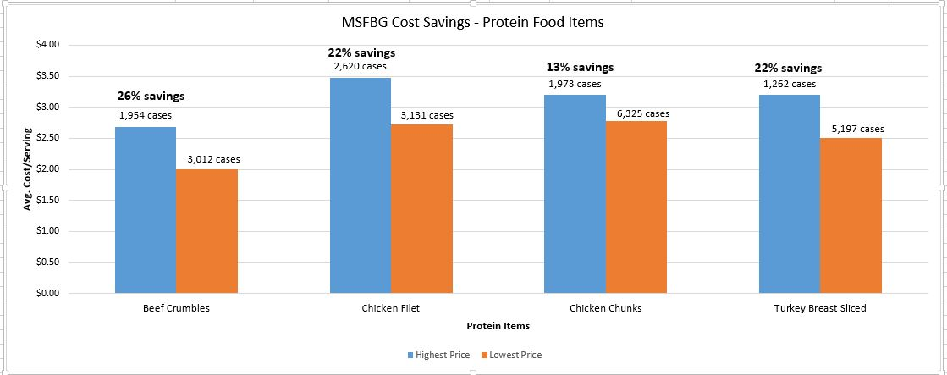
MSFBG Cost Savings – Protein Food Items

Slide 35
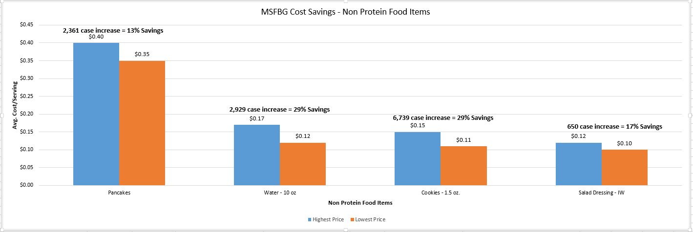
MSFBG Cost Savings – Non Protein Food Items

Slide 36
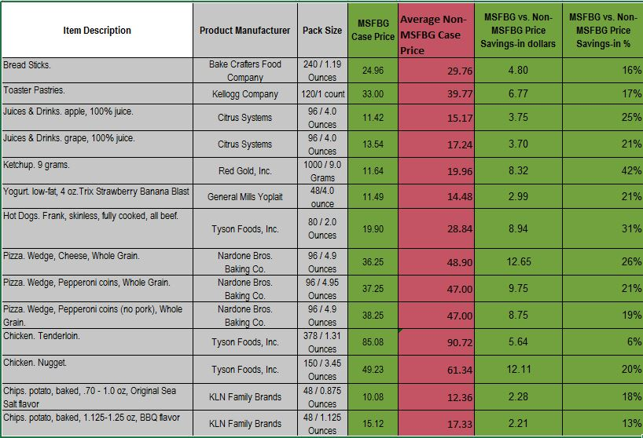
MSFBG Price Savings vs. Non-MSFBG Price Savings 2014-2015

Slide 37
Quotes from Manufacturers and Participants
“MSFBG provides the best bid allowances in the 5 state area.” MSFBG Participating Manufacturer
“MSFBG has helped me be more creative with my menu. We would never had offered the kids’ favorite of Peanut Butter and Jelly Sandwiches as a menu item, but they are affordable on the MSFBG bid. We now have a vegetarian option for our elementary students and boy do they love them!” MSFBG Participant

Slide 38
Questions

Slide 39
Thanks for Coming!
Laura Metzger, MSFBG Consultant
msfbg@ahschools.us

